Slide 1


DATA
ANALYSIS

Slide 2


Today's agenda
Project recap
Problem
The Analytics team
Process
Insights
Summary

Slide 3

Social Buzz is a fast growing technology unicorn that need to adapt quickly to it's global scale. Accenture has begun a 3 month POC focusing on these tasks:
An audit of Social Buzz's big data practice
Recommendations for a successful IPO
Analysis to find Social Buzz's top 5 most popular categories of content
Project Recap

Slide 4

Problem
Daily, over 100,000 post are made
About 36,500,000 pieces of content
per year!
How can we extract value from unstructured data at scale?
Identifying the top five most popular content types on Social Buzz.

Slide 5



Andrew Fleming Chief Technical Architect
The Analytics team
Marcus Rampton Senior Principle
Adekunle Funmilayo
Data Analyst

Slide 6
Data Gathering
1
Process
Data Cleaning
2
Data Modeling
3
4
Data Analysis
Uncovering insights
5

Slide 7

Insights
16
UNIQUE
CATEGORIES
1897
REACTIONS TO ANIMAL POST
JANUARY
MONTH WITH THE HIGHEST POST

Slide 8
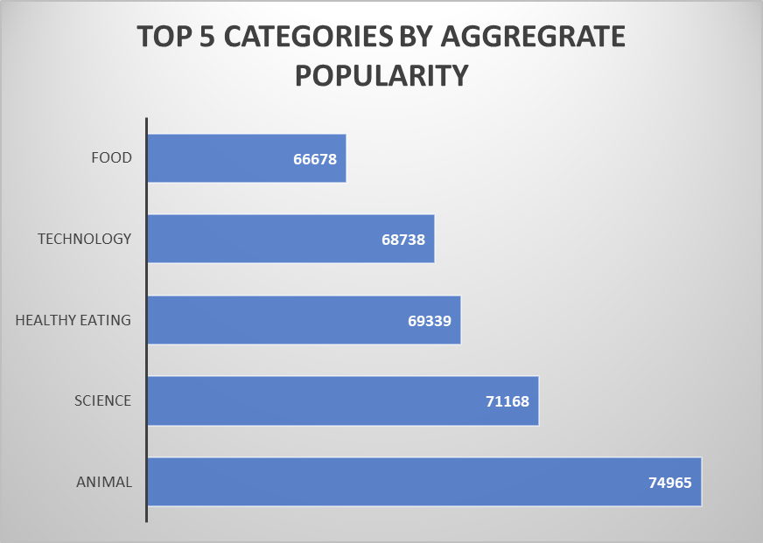

Slide 9
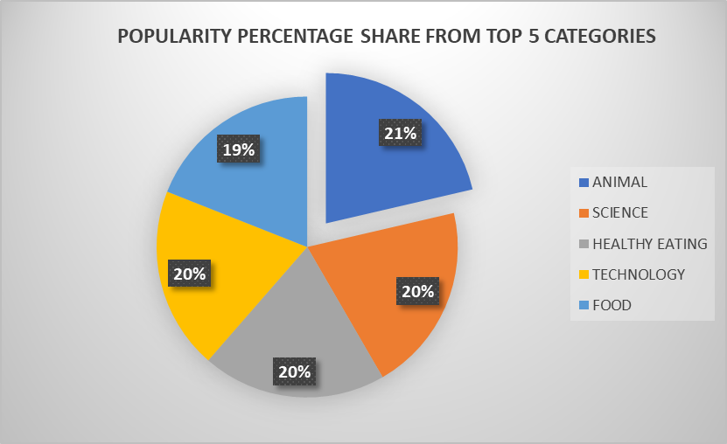

Slide 10

The two most popular categories were Animals and sciences
Top 5 categories are
Animal
Science
Healthy eating
Technology
Food
Animal: This category consistently ranks first, indicating a high level of interest or engagement from users.
Science: Science content ranks second, suggesting a strong demand for educational and informative material.
Healthy Eating: This category's popularity reflects a growing awareness of health and wellness trends.
Technology: The presence of technology in the top five highlights the platform's appeal to users interested in gadgets, software, and digital trends.
Food: Food-related content remains popular, likely due to its universal appeal and the abundance of recipes, reviews, and culinary tips
SUMMARY

Slide 11
Thank you!
ANY QUESTIONS?

